Slide 1

Introduction
Winter 1400 (Computer Aided Design), Chapter 0
Meisam Abdollahi
School of Computer Engineering
Iran University of Science and Technology
meisam.abdolahi@ut.ac.ir

Slide 2
Course Introduction (Computer Aided Design)
Instructor: Meisam Abdollahi
How to contact: meisam.abdolahi@ut.ac.ir
Course Page: ?
Course TAs: ?
Grading:
Homework & Quiz: 20%
Project: 15%
Midterm: 25%
Final: 40%

Slide 3
Course Introduction (Computer Aided Design)
Design methodologies for both combinational and sequential digital systems.
Design and implementation of digital systems (Datapath and Controller).
Knowledge and use of hardware description languages (HDLs) for system modeling and simulation.
Verilog HDL
VHDL
System Verilog & SystemC
Implementation of digital systems on reconfigurable programmable logic devices (CPLDs and FPGAs).
Hardware Simulation & Synthesis.

Slide 4
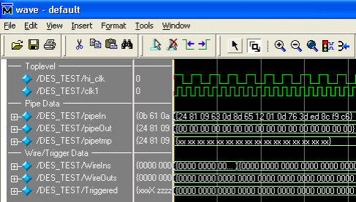
Course Introduction (Softwares)
Modelsim

Slide 5
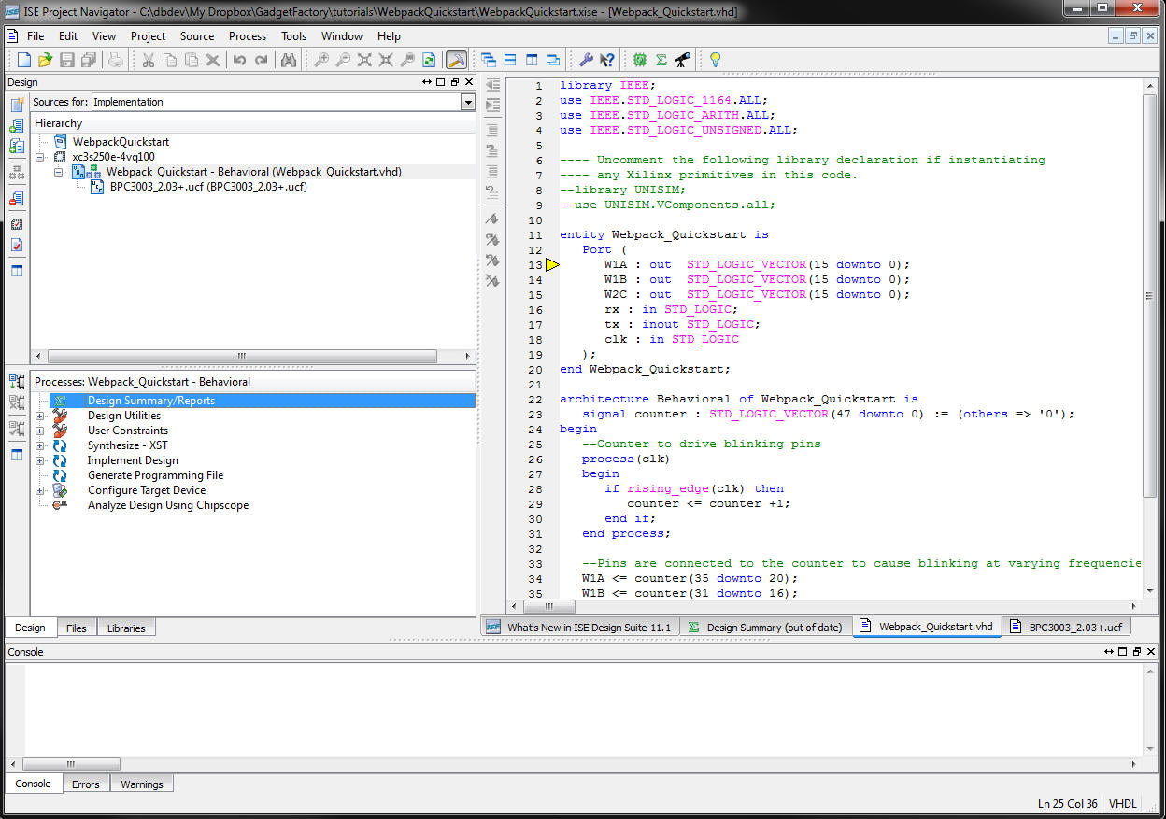
Course Introduction (Softwares)
ISE (Xilinx)

Slide 6
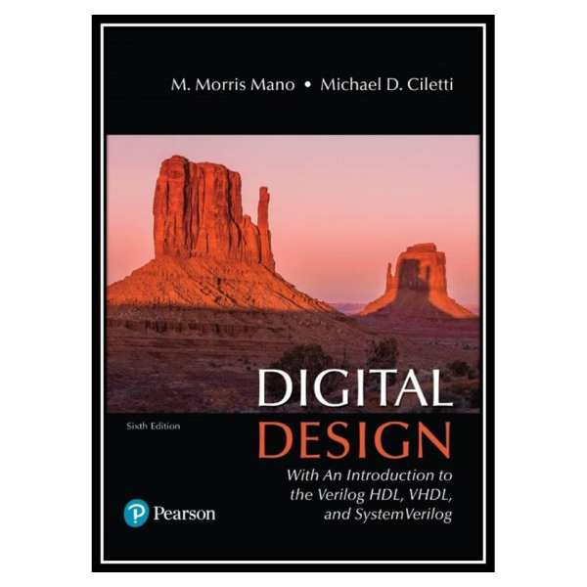
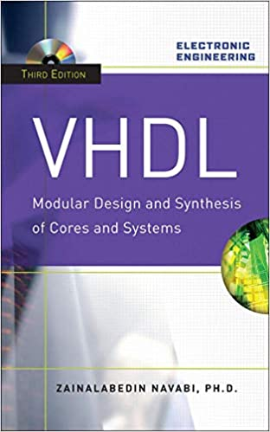
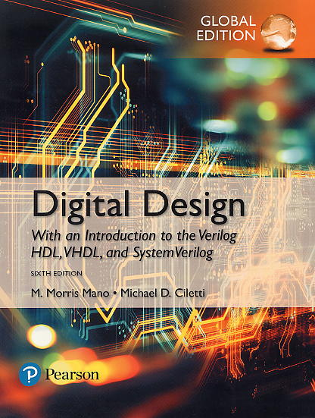
Course Introduction (Computer Aided Design)
References:
Book 1: M. Morris Mano and Michael D. Ciletti. “Digital Design With an Introduction to the Verilog HDL, VHDL, and System Verilog“, Sixth Edition (2019).
Book 2: Zainalabedin Navabi, “Verilog Digital System Design , RT Level Synthesis, Testbench and Verification” – 2nd Edition.
Book 3: Zainalabedin Navabi, VHDL modular design and synthesis of cores and systems”,

Slide 7
Semiconductor Technology
Silicon: semiconductor
Conductors
Insulators
Switch
7

Slide 8
Transistors as Switches
We can view MOS transistors as electrically controlled switches
Voltage at gate controls path from source to drain

Slide 9
CMOS Inverter
A | Y
0 | 1
1 | 0
OFF
ON
0
1
ON
OFF

Slide 10
CMOS NAND Gate
A | B | Y
0 | 0 | 1
0 | 1 | 1
1 | 0 | 1
1 | 1 | 0
OFF
ON
OFF
OFF
OFF
ON
ON
ON
1
1
0
0
ON
ON
OFF
OFF
1
0
1
0
ON
OFF
ON
OFF

Slide 11
CMOS NOR Gate
A | B | Y
0 | 0 | 1
0 | 1 | 0
1 | 0 | 0
1 | 1 | 0

Slide 12
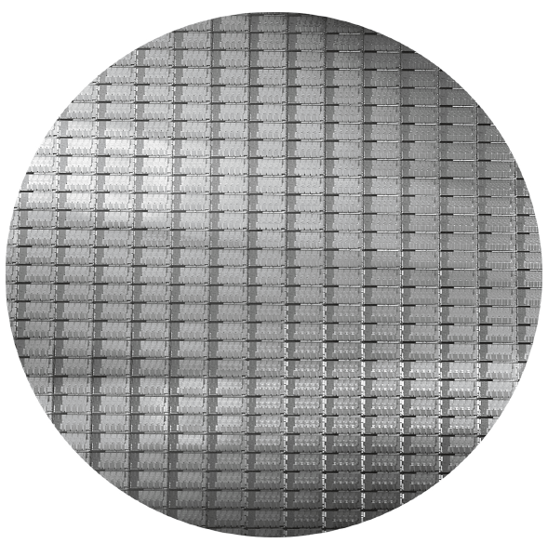
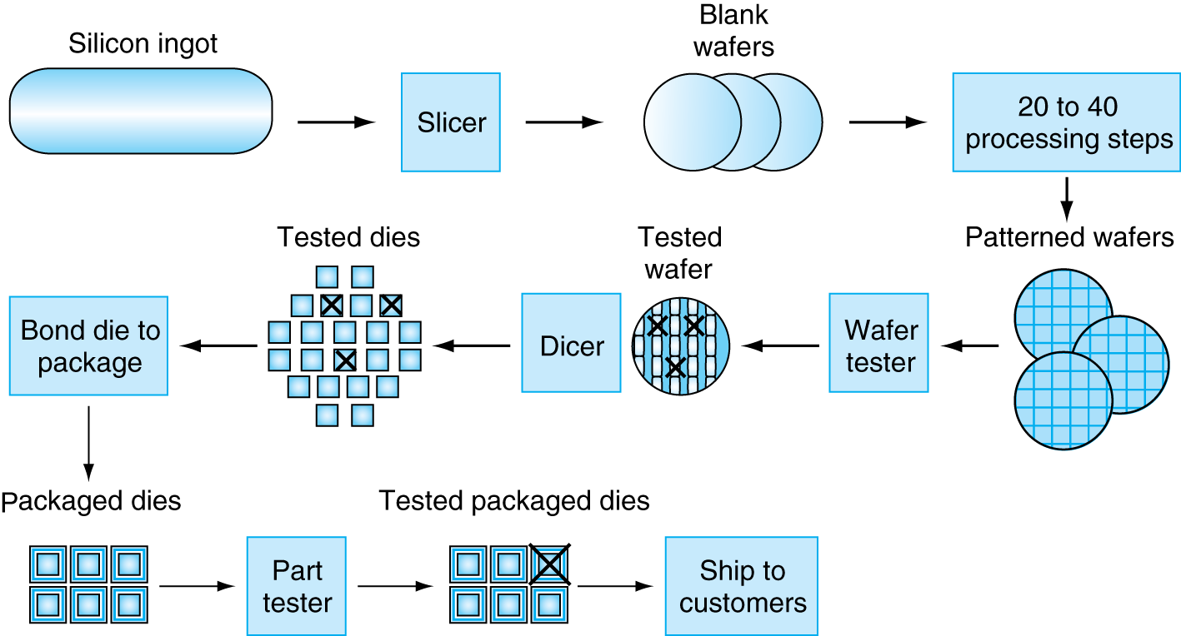
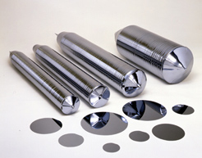

Manufacturing ICs
12

Slide 13
What is a digital system?
Structure: A collection of interconnected digital modules designed to perform a particular service or function
Function: Takes a set of discrete information inputs and discrete internal information (system state) and generates a set of discrete information outputs.
Discrete
Information
Processing
System
Discrete Inputs
Discrete Outputs
System State

Slide 14
What is a digital system?
A digital signal is a signal in which discrete steps are used to represent information and change values only at discrete (fixed) time intervals.
Analog signals have “continuous” variations in signal amplitude over time.
An analog signal has infinite possible values
Digital systems are very useful in the areas of
Signal processing
Computing
Communication
Data storage
Almost all electronic systems are partially or totally digitally based.

Slide 15
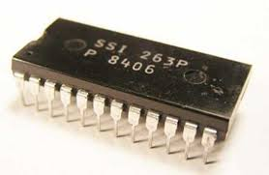
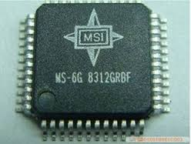
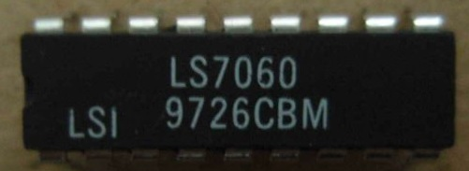
What is a digital system?
SSI (small-scale integration) [before 1960s]
circuit contains only a few transistors
MSI (medium-scale integration) [1960s]
Circuit contains hundreds of transistors on each chip
LSI (large-scale integration) [1970s]
tens of thousands of transistors per chip

Slide 16
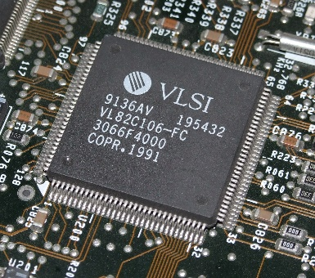
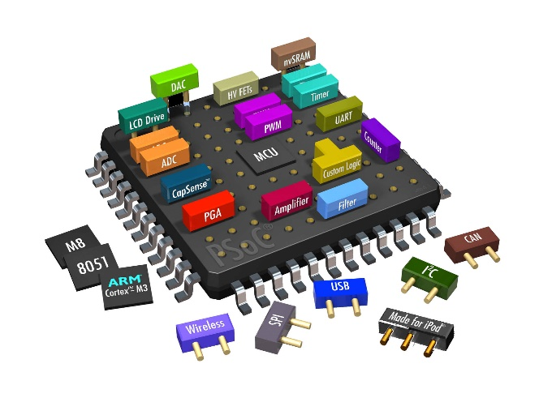
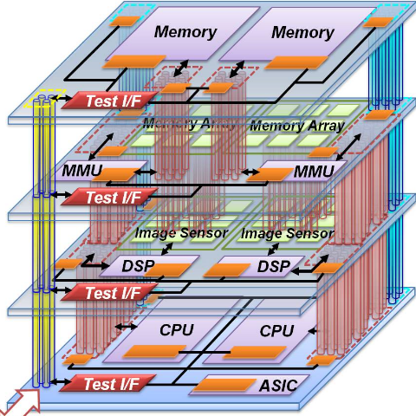
What is a digital system?
VLSI (very large-scale integration) [1980s]
Several billion transistors as of 2009
SOC (system-on-a-chip) [2000s]
integrated circuit in which all the components needed for a computer or other system are included on a single chip
(3D-IC) three-dimensional integrated circuit [2010s]
has two or more layers of active electronic components that are integrated both vertically and horizontally into a single circuit.

Slide 17
History of Digital System Design
The exponential growth in the amount of digital logic in a single pack leads to serious problems for the digital designer
How can an engineer design a digital logic circuit that will end up containing millions of transistors?
Any digital logic circuit can be made from only three types of basic gates: AND, OR, and NOT.
In fact only NAND or NOR gates
These basic gates were provided in SSI chips
Technology: transistor-transistor logic (TTL)
These TTL chips were the mainstay of digital design throughout the 1960s and 1970s
MSI TTL chips: Decoders, adders, multiplexers, comparators, and many others.

Slide 18
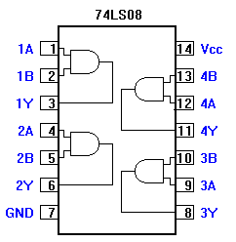

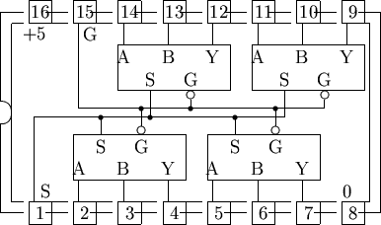
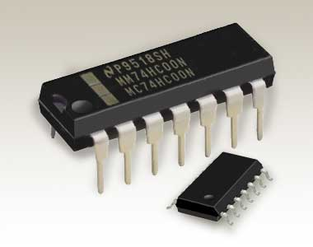
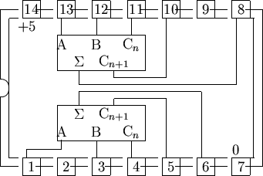
TTL technology

Slide 19
History of Digital System Design
By the 1980s thousands of gates could fit on a single chip
Several different varieties of programmable logic devices (PLDs)
Arrays containing large numbers of AND, OR, and NOT gates.
The equivalent of many PLDs on a single chip led to complex programmable logic devices (CPLDs).
In the mid-1980’s: RAM-based lookup tables instead of AND-OR gates.
These devices are called field programmable gate arrays (FPGAs).

Slide 20
Modern Design of Digital Systems
The traditional way of designing digital circuits is to draw logic diagrams containing SSI gates and MSI logic functions.
By the late 1980s and early 1990s: How can you draw schematic diagrams containing hundreds of thousands or millions of gates?
PLDs replaced TTL chips in new designs: A new approach to digital design became necessary.
Computer-aided tools are essential to designing digital circuits today.
Today digital designers use hardware description languages (HDLs) to design digital systems.

Slide 21
Modern Design of Digital Systems
A hardware description language (HDL) is a specialized computer language used to describe the structure and behavior of digital systems.
An HDL language is used for
Formal description of an electronic circuit
Simulation
The synthesis (create netlist)
Create an integrated circuit
A hardware description language looks much like a programming language such as C.
It is a textual description consisting of expressions, statements and control structures
Most widely used HDLs are VHDL and Verilog
Allow the user to design digital systems by writing a program that describes the behavior of the digital circuit
Implementation of the circuit in a CPLD, an FPGA, or an ASIC

Slide 22
Application-specific integrated circuit (ASIC)
An application-specific integrated circuit (ASIC) is an integrated circuit (IC) customized for a particular use, rather than intended for general-purpose use.
A digital voice recorder
Number of gates in an ASIC circuit: from 5,000 gates to over 100 million
A modern ASIC includes entire microprocessors, memory blocks including ROM, RAM, EEPROM, flash memory and other large building blocks.
Today’s ASIC are SoC (System on Chip).
Hardware description languages (HDL), such as Verilog or VHDL are used to describe and implement an ASIC.

Slide 23
Type of Asics

Slide 24
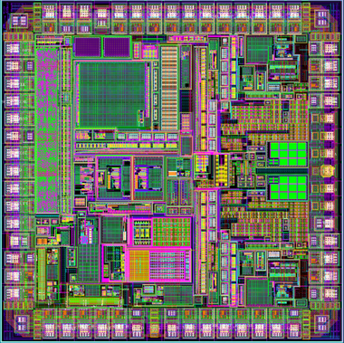
ASIC (Full-custom)
Full-Custom design
A methodology for designing integrated circuits by specifying the layout of each individual transistor and the interconnections between them.
Advantages:
Maximizes the performance of the chip
Minimizes its area
Ability to integrate analog components
Disadvantages
Increased manufacturing and design time
Non-recurring
Much higher skill requirement on the part of the design team.
It is not cost-effective when generation rate is low.

Slide 25
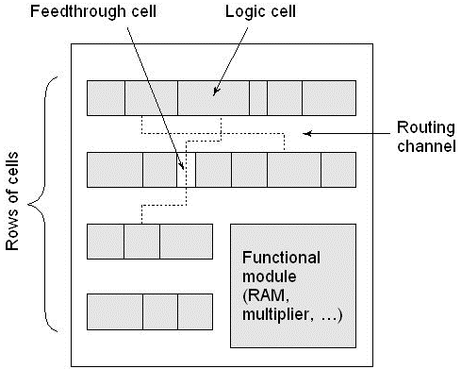
ASIC (Standard Cell)
Library of cells that implement different gates (e.g., NAND, NOR, XOR)
A standard cell is a group of transistor and interconnect structures that provides a logic gates (e.g., NAND, NOR, XOR) or a storage function (flipflop or latch).
Initially RTL (Register Transfer Language) description of the design is written
Then it is synthesized based on technology specific Standard cell libraries.
Standard cells are then used in the design by being placed in rows and wired together using ‘place and route’ CAD tools.

Slide 26
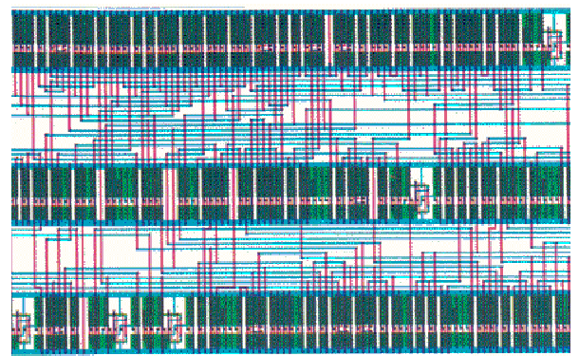
ASIC (Standard Cell)

Slide 27
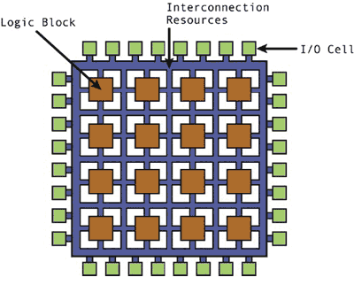
ASIC (Gate Array)
There is a fabricated array of And or OR gates at regular predefined positions and manufactured on a wafer (master slice).
Gate array master slices are usually prefabricated in large quantities regardless of customer orders.
We have to design the layout only for the interconnects.
An application circuit must be built on a gate array that has enough gates, wiring and I/O pins.

Slide 28
Standard Cell vs. Gate Array
The standard cell has variable cell and wiring channel width, whereas both are fixed in the gate array.

Slide 29
ASIC (FPGA)
Filed Programmable Gate Array (FPGA):
Semiconductor devices that can be programmed.
Desired functionality of the FPGA can be re-programmed by downloading the reconfiguration into device
The FPGA configuration is specified using hardware description language (HDL).
FPGAs can be used to implement any digital system that an ASIC can perform.

Slide 30
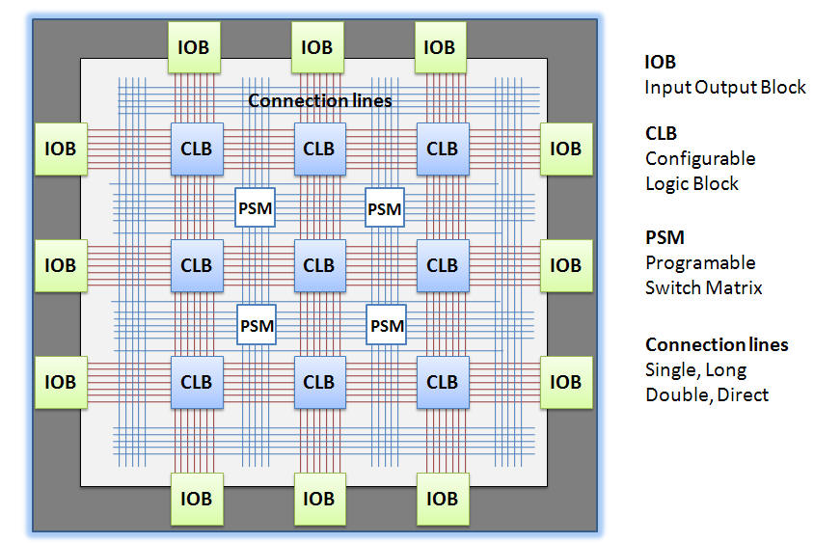
FPGA Architecture
CLB: 25%
Interconnection: 75%

Slide 31
FPGA
FPGA were introduced in 1985 by Xilinx (the XC2064).
Consists of an array of programmable logic blocks surrounded by programmable interconnects.
Can be configured by end-users to implement specific applications.
Capacity up to multi millions logic gates and speed up to 1 GHz.
Famous companies
Xilinx
Altera (Intel)
Actel

Slide 32
FPGA vs. Microcontroller
FPGA advantages
Microcontroller advantages
Implement “any” functionality
0-100x performance for suitable tasks
Multicore design available
Testing circuit is easy
Easy reconfigurable
Parallel processing
One FPGA can configured to be 200 atmega32
Datasheet available
Drivers, code, examples available on the Internet
Implementing the circuit on the breadboards

Slide 33
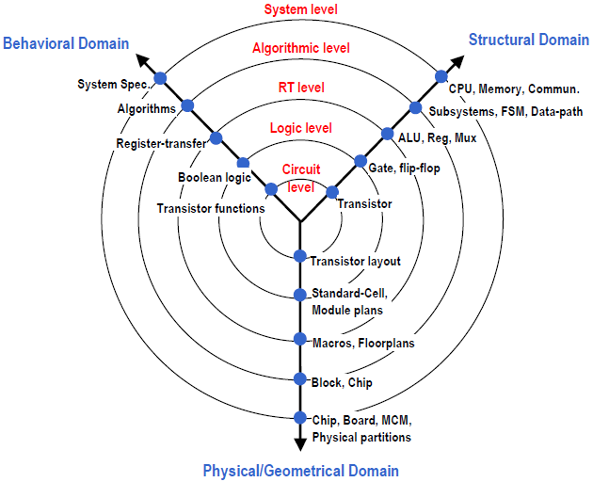
Different perspectives in the hardware design

Slide 34
Fundamental Concepts
Model:
The model represents that information which is relevant and abstracts away from irrelevant detail. The implication of this is that there may be several models of the same system, since different information is relevant in different contexts.
One kind of model might concentrate on representing the function of the system, whereas another kind might represent the way in which the system is composed of subsystems.

Slide 35
Fundamental Concepts
Domains and levels of Modeling (Y-chart)
The radial axes show the three different domains of modeling.
The concentric rings show the levels of abstraction, with the more abstract levels on the outside and more detailed levels toward the center.

Slide 36
Fundamental Concepts
Domains and levels of Modeling (Y-chart)
A behavioral view describes the functionality of the design in terms of abstract concepts, independent of any implementation details.
Building blocks of a behavioral description are abstract entities that do not represent physical components.
Each block describes a piece of functionality that takes inputs, processes them and finishes after producing its output.
Functional
(Behavioral)

Slide 37
Fundamental Concepts
Domains and levels of Modeling (Y-chart)
A structural view describes the design architecture as a netlist of lower-level components and their connectivity.
Building blocks of a structural description represent real, physical objects.
Structural

Slide 38
Fundamental Concepts
Domains and levels of Modeling (Y-chart)
A physical view describes the spatial layout of the lower-level components on the chip.
A physical view describes the floor-plan of how the components and their interconnect are placed and routed on the chip.
Geometry

Slide 39
Fundamental Concepts
Design Flow:
In general, design is the process of moving from a behavioral to a structural (and eventually physical) description at a certain level, implementing the desired functionality through an architecture of subcomponents.
At the next lower level of abstraction, the subcomponents, in turn, are designed by moving from a behavioral description to a structural (and physical) description of the subcomponent.

Slide 40
Fundamental Concepts
Design Flow:
A design flow can be bottom-up or top-down.
In a bottom-up approach, design moves from the lowest level of abstraction up to the system level by assembling previously designed components such that the desired behavior is achieved at each level.
In a top-down approach, design starts with a specification of the system behavior and moves down in the level of abstraction by mapping the desired behavior at each level onto a set of components and specifying the behavior of each component for the next level.

Slide 41
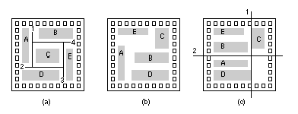
Fundamental Concepts
Design Flow example (System Level)

Slide 42
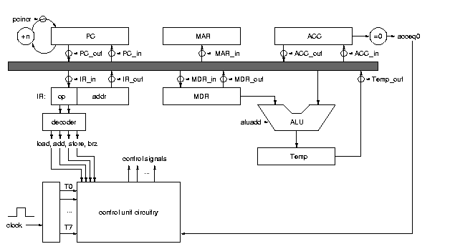
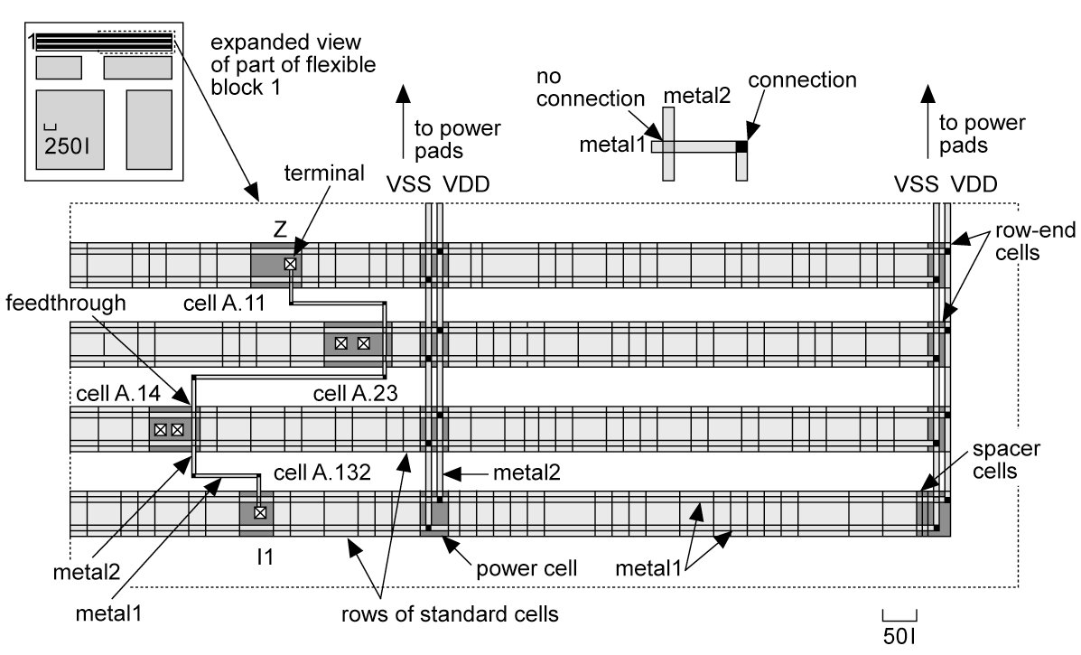
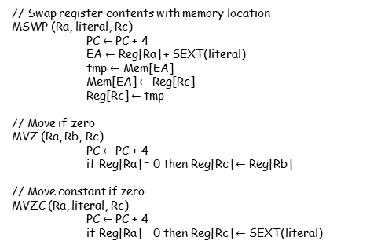
Fundamental Concepts
Design Flow example (Register Transfer Level)
// Swap register contents with memory location
MSWP (Ra, literal, Rc)
PC $←$ PC + 4
EA $←$ Reg[Ra] + SEXT(literal)
tmp $←$ Mem[EA]
Mem[EA] $←$ Reg[Rc]
Reg[Rc] $←$ tmp
// Move if zero
MVZ (Ra, Rb, Rc)
PC $←$ PC + 4
if Reg[Ra] = 0 then Reg[Rc] $←$ Reg[Rb]
// Move constant if zero
MVZC (Ra, literal, Rc)
PC $←$ PC + 4
if Reg[Ra] = 0 then Reg[Rc] $←$ SEXT(literal)

Slide 43
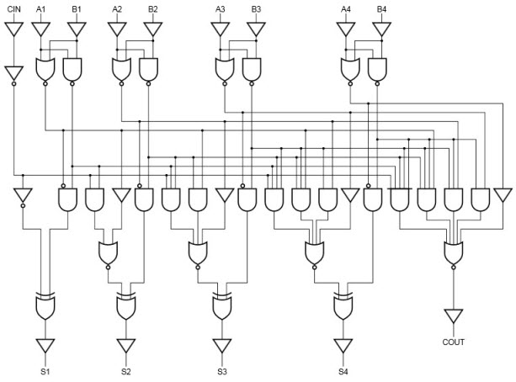
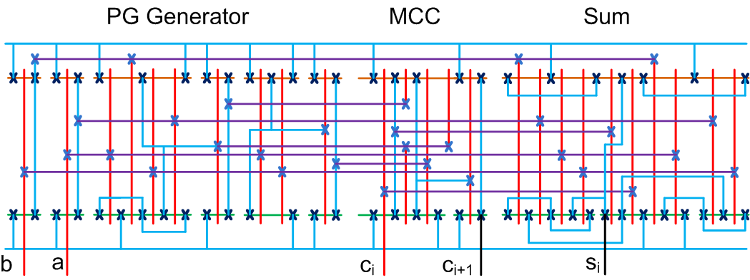
Fundamental Concepts
Design Flow example (Gate Level)
c0 = g−1.
c1 = g−1p0 + g0.
c2 = g−1p0p1 + g0p1 + g1.
c3 = g−1p0p1p2 + g0p1p2 + g1p2 + g2

Slide 44
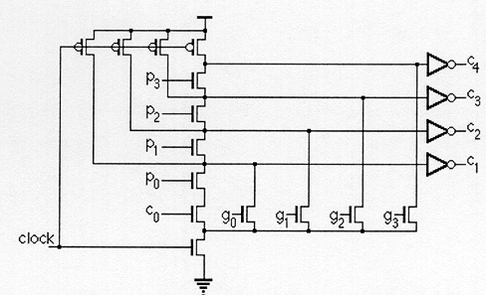
Fundamental Concepts
Design Flow example (Register Transfer Level)

Slide 45
Fundamental Concepts
Domains and levels of Modeling (Example)
An algorithm for an instrument controller (Behavioral Model)
loop
for each data input loop
read the value on this input;
scale the value using the current scale factor for this input;
convert the scaled value to a decimal string;
write the string to the display output corresponding to this input;
end loop;
wait for 10 ms;
end loop;
A PMS Model for the controller Structure (Structural Modeling)
P : processor
M : memory
S : interconnection switch
Kio : input/output controllers

Slide 46
Fundamental Concepts
Domains and levels of Modeling (Example)
A floor plan model of the controller geometry
In the geometric domain at this top level of abstraction, a system to be implemented as a VLSI circuit may be modeled using a floor plan. This shows how the components described in the structural model are arranged on the silicon die.

Slide 47
Fundamental Concepts
Domains and levels of Modeling (Example)
Register-Transfer-Level structural model of the controller processor.
GPR : General Purpose Register file
PC : Program Counter
MAR : Memory Address Register
MDR : Memory Data Register
Temp : Temporary values Register
IR : Fetched Instructions Register
ALU : Arithmetic and Logic Unit
Bus Drivers
Control Unit section

Slide 48
Fundamental Concepts
Domains and levels of Modeling (Example)
The functional domain (Register-Transfer Level)
MAR ← PC, memory_read ← 1
PC ← PC + 1
wait until ready = 1
IR ← memory_data
memory_read ← 0

Slide 49
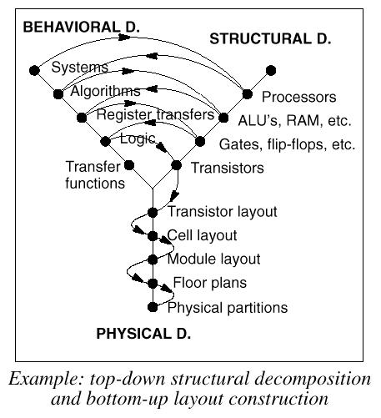
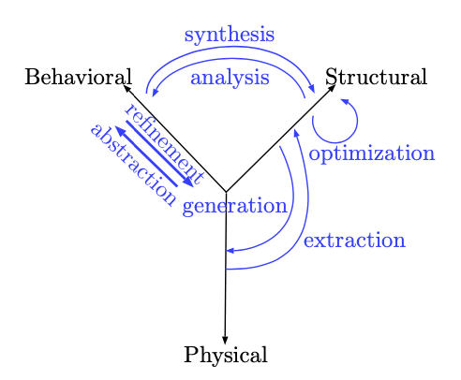
Fundamental Concepts
Digital Design Flow

Slide 50
Fundamental Concepts
Digital Design Flow
Design Entry (HDL Design)
Verification (Pre-Synthesis Simulation)
Synthesis
Timing Analysis
Post Synthesis Simulation
Hardware Generation
Obtained from Dr. Navabi Book slides

Slide 51
Fundamental Concepts
Digital Design Flow
Design Entry
Structural Description
4-to-1 Multiplexer
module mux4_to_1_structural (i0, i1, i2, i3, s1, s0, out);
input i0, i1, i2, i3, s1, s0;
output out;
wire s1n, s0n; // Internal wire
wire y0, y1, y2, y3;
// Gate instantiations
not (s1n, s1); // Create s1n and s0n signals
not (s0n, s0);
and (y0, i0, s1n, s0n);
and (y1, i1, s1n, s0);
and (y2, i2, s1, s0n);
and (y3, i3, s1, s0);
or (out, y0, y1, y2, y3);
endmodule

Slide 52
Fundamental Concepts
Digital Design Flow
Design Entry
Behavioral Description
4-bit up/down Counter
module counter (input [3:0] d_in, input clk, rst, ld, u_d,
output reg [3:0] q);
always @( posedge clk ) begin
if( rst )
q = 4’b0000;
else if( ld )
q = d_in;
else if( u_d )
q = q + 1;
else
q = q - 1;
end
endmodule

Slide 53
Fundamental Concepts
Digital Design Flow
Pre-synthesis Simulation
Simulation and Test of a designed system functionality before Hardware generation
By generation of a test data and observation of simulation results
Testbench : An HDL module
Inside the Testbench: Instantiation of the design module Forms a simulation model together with the design, used by a HDL simulation engine
When testing a digital logic device, we apply a stimulus to the inputs of the device and check its response to establish that it is performing correctly. The input stimulus is referred to as a test pattern.

Slide 54
Fundamental Concepts
Digital Design Flow
Design Validation
An important task in any digital system design
The process to check the design for any design flaws
A design flaw due to:
Ambiguous Problem Specifications
Designer Errors
Incorrect Use of Parts in the Design
Can be done by:
Simulation
Assertion Verification
Formal Verification

Slide 55
Fundamental Concepts
Simulation
The Required Test data:
generated graphically using waveform editors
through a testbench
Outputs of simulators:
Waveforms (for visual inspection)
Text (for large designs for machine processing)
Obtained from Dr. Navabi Book slides

Slide 56
Fundamental Concepts
Simulation
Testbench for the
Counter Circuit
Verilog Code of a Counter Circuit
The simulation results in form of a waveform
Obtained from Dr. Navabi Book slides

Slide 57
Fundamental Concepts
Simulation
The testbench instantiates the design under test, and as part of the code of the testbench it applies test data to the instantiated circuit.
Obtained from Dr. Navabi Book slides

Slide 58
Fundamental Concepts
Simulation
Validates the functionality of the counter circuit being tested, Regardless of
clock frequency
Obtained from Dr. Navabi Book slides

Slide 59
Fundamental Concepts
Synthesis
The output of Synthesis tool

Slide 60
Fundamental Concepts
Synthesis
The output of Synthesis tool
A list of gates and flip-flops and their interconnection

Slide 61
Fundamental Concepts
Synthesis
After the Synthesis Phase a complete netlist of target hardware components and their timings is generated.
The generated netlist includes:
The details of gates used for the implementation of the design.
Wiring delays and load effects on gates used in the post-synthesis design.

Slide 62
Fundamental Concepts
Post-synthesis simulation
A Post-synthesis simulation checks:
Timing issues
Determination of a proper clock frequency
Determination of race, and hazard considerations
The behavior of a design as intended by the designer and its behavior after post-synthesis simulation may be different due to delays of wires and gates.

Slide 63
Compilation and Synthesis
Input: Hardware description consisting of various levels of Verilog
The compilation process and a graphical representation for each of the compilation phase outputs
Output:
A detailed hardware for programming an FPGA or manufacturing an ASIC
Compilation and Synthesis Process

Slide 64
Compilation and Synthesis
Analysis Phase: Translates various parts of the design to an intermediate format.
Compilation and Synthesis Process (Continued)

Slide 65
Compilation and Synthesis
Synthesis Phase: Links all parts together and generates the corresponding logic.
Has three different phases.
Compilation and Synthesis Process (Continued)

Slide 66
Compilation and Synthesis
Routing and Placement Phase: Places and routes components of the target hardware, and generates timing details.
Compilation and Synthesis Process (Continued)

